Slide 1
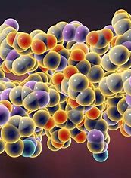
Cell Requirements
AEHBY ATAR Human Biology

Slide 2
Review
Define active (in the context of cells)
Classify membrane transfer types as active or passive.
Which molecule(s) are the source of energy for cells?
List the three stages of cellular respiration and state the amount of energy molecules produced in each.
Why do mitochondria contain internal membranes?

Slide 3
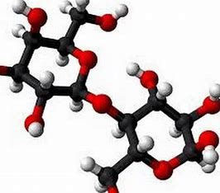
Learning Intentions
cells require oxygen and nutrients, including carbohydrates, proteins, lipids, vitamins and minerals

Slide 4
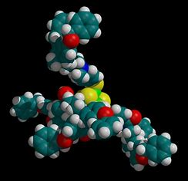
Success Criteria
Describe the four main types of macromolecules
Explain the difference between vitamins and minerals

Slide 5
Cell requirements
Cells require raw materials for anabolic processes that make cell components or products, and catabolic processes that release energy from them.

Slide 6


Slide 7

Vitamins
organic molecules, essential for normal cell function
often cofactors or coenzymes, necessary for metabolic processes.
the cell is unable to synthesis in sufficient quantities.
may be water soluble or lipid soluble

Slide 8
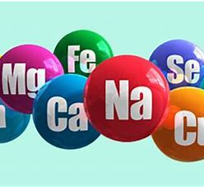
Minerals
inorganic elements essential for cell function
often required in only small amounts
many functions including enzyme activity

Slide 9
Questions
What is a monomer?
Which biomolecule is a reactant for cellular respiration?
Which cell components are made of proteins?
Which cell components are made of lipids?
Summarise the elements contained in each class of biomolecules.
Explain the difference between a vitamin and a mineral.

Slide 10
Success Criteria
Describe the four main types of macromolecules
Explain the difference between vitamins and minerals

